Slide 1
MGT388 Finance and law for Engineers
Appraisal of Annual Reports using Ratio Analysis

Slide 2
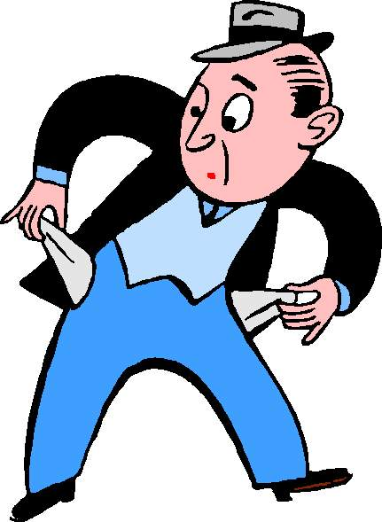

Liquidity and efficiency
Liquidity refers to the ability of a business to generate sufficient cash to pay its liabilities as they fall due.
Liquidity is directly linked to the short term solvency of a business. A business will go bankrupt if it cannot pay its debts.

Slide 3
Liquidity and efficiency
A company with good working capital management will be able to meet the debts as the fall due.
Working capital is:
Current assets- Current liabilities
Inventory
Trade receivables
Cash
Trade payables
Tax payable
Overdraft

Slide 4
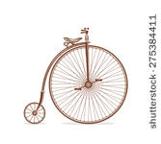

Liquidity and efficiency
Working capital management will mean:
not holding too much inventory for
too long,
good collection policy on trade receivables
prompt payment of trade payables
Inadequate and inefficient working capital policies may lead to an overdraft which is an expensive form of finance.

Slide 5
Working capital cycle
Purchase inputs
production
inventories
sales
Trade receivables
cash

Slide 6

Working capital Management

Slide 7
Liquidity and Efficiency Ratios
Ability to make payments
Current ratio
Acid Test ratio
Efficiency ratios
Inventory holding period
Trade receivables collection period
Trade payables payment period

Slide 8
Example – VEG continued
Income Statement £’000
Revenue 800
Cost of sales (520)
Gross profit 280
Current Assets £’000 Current Liabilities £’000
Inventory 40 Trade payables 50
Trade receivable 140 Overdraft 40
180 Corporation tax 12
102

Slide 9

Current Ratio
Current ratio = Current Assets 180 1.76 x Current Liabilities 102
For every £1 of current liability the company has £1.76 of current assets.
This would indicate debts could be met when they fall due.
The industry is very important typically supermarkets have low current ratios as they have few trade receivable but high levels of trade payables
Notes:
9

Slide 10
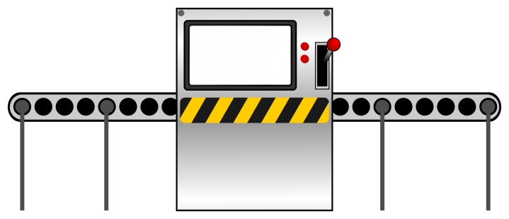

Current Ratio
Is a High Current Ratio Good?
Too high a ratio can mean inefficiency a company should not hold large reserves of cash.
The cash should be invested and generating profits.
Similarly high levels of inventory and trade receivables will indicate they are not being efficiently managed and cash will be tied up.

Slide 11
Analysis of Current Ratio For VEG
Although the business does not appear to have liquidity problems the components of current assets and current liabilities need to be looked at closer.
A low level of inventory should be expected as the items are perishable and have limited shelf life. Too high a level may indicate obsolete items.
The trade receivables represents money owed from customers in this case a few large supermarkets. It may be that the supermarkets can demand extended credit which would suggest a high receivables value.
The current liabilities are largely an overdraft and trade payables, as this is a new business it is unlikely that VEG will have been offered good credit terms from suppliers and an overdraft is repayable on demand.
So although by looking at the current ratio, VEG can meet its liabilities as they fall due it is necessary to look at the length of time the supermarkets take to pay and VEG takes to pay its suppliers, if there is a mismatch in the time periods, it could be that any expansion would lead to liquidity problems.

Slide 12
Acid test ratio
Acid test ratio
Current assets- inventory 180-40 = 1.37
Current Liabilities 102
Why remove inventory?
The time lag of turning inventory into cash
Inventory Trade receivable Cash

Slide 13

Analysis of Acid Test For Veg
The inventory for VEG is perishable and so will have to be converted and sold quickly and so this ratio may not be as relevant here.

Slide 14


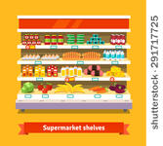
Inventory Holding Period
Inventory holding period = Closing inventory X 365 days
Cost of sales
Inventory holding period 31/12/16
40 X 365 days = 28 days
520
Forecast inventory holding period
30 x 365 days = 18 days 620
Notes:
14

Slide 15
Analysis of Inventory Holding Period for VEG
For VEG forecast inventory levels are not expected to increase despite more than a 25% expected growth in revenue.
In fact the inventory days are forecast to reduce from 28 days to just 18 days.
It should be expected that inventory levels would be low as the raw materials are perishable.
As this is a new business the investment in training and technology may have improved the transition time from fruit to smoothie making the whole process more efficient. Good management?

Slide 16
Trade Receivables Collection Period
Collection period Trade receivable X 365 days
Revenue
Collection period for 31/12/2016
140 X 365 days = 64 days
800
Forecast collection period
290 X 365 days = 104 days
1,020
Notes:
16

Slide 17

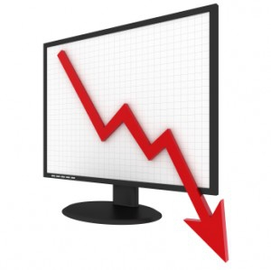
Trade Receivables Collection Period
If too long a collection period
may indicate poor collection policy.
Or unsatisfied customers who are refusing to pay, poor quality product.
If too short a collection period
may lose customers to competitors who offer better credit terms
Or may be offering discount for prompt
payment which will effect margins.

Slide 18
Analysis of Trade Receivables Collection Period for VEG
For VEG the forecast is for the collection period to increase by 63% despite the increase in sales of only 25%. This may be explained by the fact the customers of VEG are large supermarkets, who are in a powerful position to demand long payment periods. If VEG cannot obtain equally beneficially terms from its suppliers (being a new and small business this is unlikely) the directors should seek to secure finance to bridge the gap between cash from customers and payments to suppliers.
An overdraft facility will help but high interest rates and charges may apply another way around this is to sell the debts to a factoring company. ( A factoring company will buy the trade receivables from a business, so if a business is owed £3,000 a factoring company will pay the business £2,750 and take the debt. The business has cash quickly and has not had to chase customers for payments but has had to pay £250 for the service. The factoring company hopes to make £250 when it collects in the debts).
The directors of VEG will need to decide the most appropriate way to fund the credit given to the large supermarkets.

Slide 19

Trade Payable Payment Period
Payment period Trade payables X 365 days
Cost of sales
Payment period 31/12/16
50 X 365 days = 35 days 520
Notes:
19

Slide 20


Trade Payable Payment Period
The trade payable payment period should match trade receivable collection period.
Is a long payment period good?
If pay on a timely basis may
receive discount which will help with
profitability compared to competitors.
If too high may have a poor relationship with suppliers which could effect future supplies and prices.

Slide 21
Analysis of For Veg
For VEG the payment period of 35 days appears very high especially considering the business is perishable supplies and the directors will have to work hard to maintain a good relationship with these suppliers.
Even though the payment period is high there is still a mismatch with the collection period again highlighting the need to ensure suitable short term finance.

Slide 22
Long term and medium term solvency
Can the business survive in the medium/long term?
Once the short term liquidity is assessed it is necessary to look at the medium-term capital structure of a business.
This will help assess the potential of risk to the investor.

Slide 23
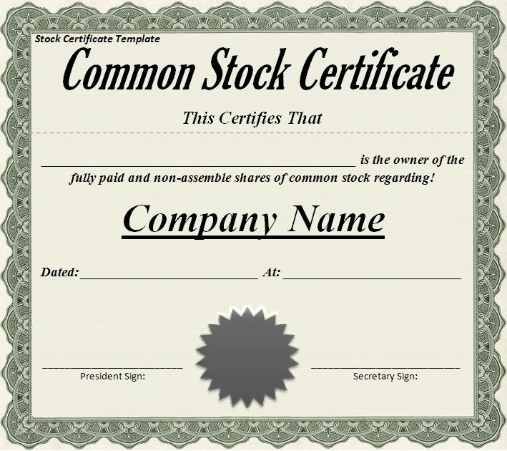


What is the risk to investors?
Investors face a risk of not receiving an annual return on their investment and also not having their investment repaid.

Slide 24
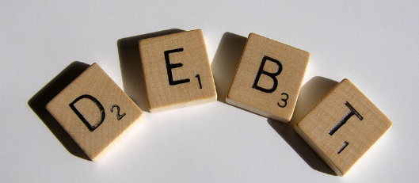
Solvency
The solvency of a business can be assessed by looking at its gearing.
Financial Gearing (leverage) looks at how the company is financed.
If a business has a high level of non-current liabilities (DEBT) there is a potential risk that in the medium-long term these loans cannot be repaid and the business will fail. Financial Risk

Slide 25
Solvency
Debt
Debt includes non-current liabilities and normally preference shares.
Preference shares need to be considered carefully if they carry a fixed rate of interest which is to be paid annually and are to be repaid before ordinary shares in a winding up they are regarded as debt.
If the business has a current loan or overdraft that is semi-permanent it should also be regarded as debt.
Equity
Ordinary share capital plus the reserves. This is because the reserves that belong to the equity shareholders

Slide 26
Solvency
GEARING
DEBT TO EQUITY RATIO
DEBT / EQUITY = LOANS + OVERDRAFTS
SHARE CAPITAL + RESERVES

Slide 27
Gearing using VEG
Debt
Long-term borrowing 350
Short term borrowing 40
390
Equity
Ordinary shares 100
Retained earnings 30
130
Debt and Equity
Debt 390
Equity 130 520

Slide 28
Gearing Example
Debt to Equity ratio
Debt = 390 = 3X
Equity 130

Slide 29
Gearing for VEG
The gearing level for VEG is very high and as VEG is a new entity it would mean it is unlikely that VEG could raise any more finance to fund the expansion.
To attract finance VEG could offer the new property, plant and equipment as security but even so any provider of a loan would see it as high risk and would ask for high interest payments.
As interest payments are an item of expense the profitability of VEG would be reduced should any further loans be taken on.
The directors will probably look towards obtaining finance through issuing shares (equity) which would mean they would be interested in your investment offer.

Slide 30
Gearing and the Income Statement
A business that is highly geared (a high level of debt) with have high levels of interest payable (finance charges).
The interest payable must be met from the operating profit. In order to assess the financial risk of a business not being able to meet the interest payments an interest cover ratio is calculated.
Interest cover = Operating profit
Interest payable
2016 interest cover 70 3.5X
20
Forecast interest cover 210 8.4X
25

Slide 31
Interest Payments for VEG
The financial risk for VEG in 2016 is highlighted by the fact operating profit is only 3.5x more than the required interest payments.
A small drop in profits would mean that interest payments could not be met and the business would be struggling to survive.
From the forecast it can be seen the directors are aware of this and do not intend to increase the level of loans to fund the increased revenue. With a forecast interest cover of 8.4X the business would be financially more stable.

Slide 32
VEG : Summary
Should an investment be made in VEG?
The business appears profitable and well run the concerns would be:
Relying on the competitive advantage of the new technology. Is the intellectual property protected? Is any further advancement likely? Who are the competitors?
Reliance on a few large supermarkets. Are there any other potential customers? The length of the contracts? The credit terms offered to supermarkets are a concern.
Confirmation that no further debt will be taken on and future dividend payments and share re-purchase by the current directors.

Slide 33
The Impact of gearing
In order to explore the financial risk of gearing further the next few slides look at the effect on profits of a two companies one of which has a high level of debt (highly geared) and one which has a low level of debt (low gearing).

Slide 34
THE IMPACT OF GEARING Co A (low geared) and Co. B (high geared)
 | A (Good Year) | A (Poor Year) | B (Good Year) | B (Poor Year)
Share capital | 100,000 | 100,000 | 10,000 | 10,000
Debt (15%) | 10,000 | 10,000 | 100,000 | 100,000
 | 110,000 | 110,000 | 110,000 | 110,000

Slide 35
THE IMPACT OF GEARING Co A (low geared) and Co. B (high geared)
 | A (Good Year) | A (Poor Year) | B (Good Year) | B (Poor Year)
Share capital | 100,000 | 100,000 | 10,000 | 10,000
Debt (15%) | 10,000 | 10,000 | 100,000 | 100,000
 | 110,000 | 110,000 | 110,000 | 110,000
Operating profit | 64,000 | 16,000
Interest charge | 1,500 | 1,500
Profit before tax | 62,500 | 14,500
75% fall in operating profit leads to a 76.8% fall in PBT.

Slide 36
THE IMPACT OF GEARING Co A (low geared) and Co. B (high geared)
 | A (Good Year) | A (Poor Year) | B (Good Year) | B (Poor Year)
Share capital | 100,000 | 100,000 | 10,000 | 10,000
Debt (15%) | 10,000 | 10,000 | 100,000 | 100,000
 | 110,000 | 110,000 | 110,000 | 110,000
Operating profit | 64,000 | 16,000 | 64,000 | 16,000
Interest charge | 1,500 | 1,500 | 15,000 | 15,000
Profit for before tax | 62,500 | 14,500 | 49,000 | 1,000
75% fall in operating profit leads to a 76.8% fall in PBT.
75% fall in operating profit leads to a 98% fall in PBT.

Slide 37
The Impact of Gearing
It can be seen that a highly geared firm has a greater financial risk. This is because the interest charge is fixed and must be repaid no matter what the level of profit or loss.
So why have debt?
If a firm wants to expand financing by debt will not dilute the share ownership of the company.
The interest and repayment period can be negotiated and are known.
The interest charge is deducted from profits before calculating tax. Interest payments therefore have the effect of shielding income from tax.
Dividends are paid out after tax.
Is there an ideal amount of debt?
It will depend on the type of business and the level of risk equity shareholders are prepared to take.

